Slide 1
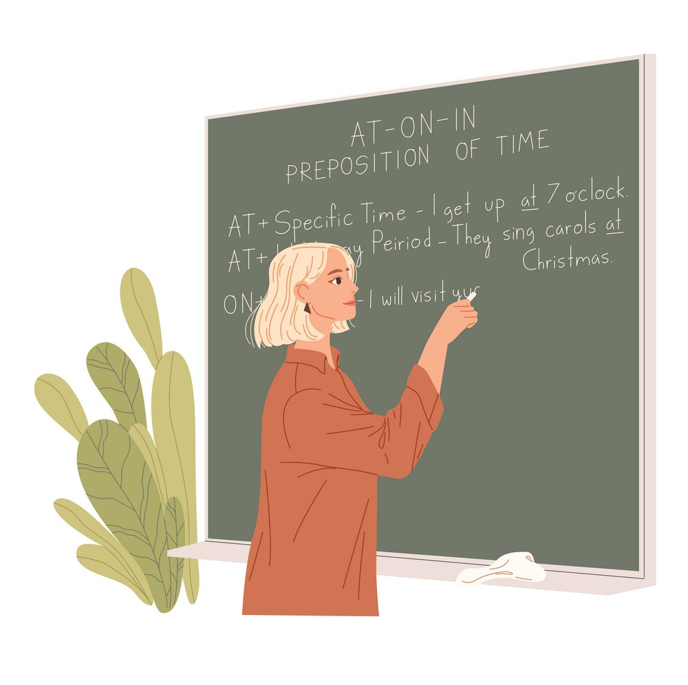
Ms .Alice
A: Who is the woman ?
B: The woman who is teaching English is Ms. Alice.

Slide 2
RELATIVE CLAUSE
The woman /who is teaching English / is Ms. Alice.
relative clause (adjective clause)
relative pronoun

Slide 3
Relative pronouns
WHO, WHOM, WHICH, WHOSE, THAT
Example 1:
The man is a famous doctor. He lives next door.
subject, person
The man / who lives next door /is a famous doctor.

Slide 4
Relative pronouns
WHO, WHOM, WHICH, WHOSE, THAT
Example 2:
The man is a famous doctor. You saw him yesterday.
object , person
The man /whom you saw yesterday / is a famous doctor.

Slide 5
Relative pronouns
WHO, WHOM, WHICH, WHOSE, THAT
Example 3:
The flowers are called tulips. They are on the table.
subject, thing
The flowers /which are on the table/ are called tulips.

Slide 6
Relative pronouns
WHO, WHOM, WHICH, WHOSE, THAT
Example 4:
The man is a famous doctor. His daughter is my close friend.
possessive
The man /whose daughter is my close friend/ is a
famous doctor.

Slide 7
Relative pronouns
WHO, WHOM, WHICH, WHOSE, THAT
Examples:
The hospital /whose rooms are well-equipped/
/ the rooms of which are well-equipped/
was built in 2018.
I can see the girl and her dog /that are in the park

Slide 8
Relative pronouns
WHO, WHOM, WHICH, WHOSE, THAT
Examples:
The hospital /whose rooms are well-equipped/
/ the rooms of which are well-equipped/
was built in 2018.
I can see the girl and her dog /that are in the park

Slide 9
Relative adverbs
WHEN; WHERE; WHY
Examples:
I can’t remember the day /when I said goodbye to him.
time
Do you remember the bus stop /where I met you.
place
I don’t know the reason/ why you are sad.
reason

Slide 10
Defining and non-defining Relative clause
Ex 1: The man who keeps the school library is Mr. Pike.
Defining clause
Ex 2: That woman, whom you saw yesterday, is Ms. Wendy
Non-defining clause

Slide 11
Defining and non-defining Relative clause
Ex 1: The man who keeps the school library is Mr. Pike.
Defining clause
Ex 2: That woman, whom you saw yesterday, is Ms. Wendy
Non-defining clause

Slide 12
Reducing Relative clause
Ex 1: The man who is reading a book in the coffee shop is
reading a book in the coffee shop is
present participle phrase
my teacher.
Ex 2: The meat which is sold in the Coop Food is very fresh.
sold in the Coop Food is very fresh.
past participle phrase

